Slide 1
LINKED LIST Oswald c
The class notes are a compilation and edition from many sources from the materials of pioneers in Data Structures from CMU, HKUST, IIT KGP, U Texas, NorthWestern Univ.. The faculty does not claim intellectual property or ownership of the lecture notes. Thanks to them!

Slide 2
Have a look at this!
"All the kids who did great in high school writing pong games in BASIC for their Apple II would get to college, take CompSci 101, a data structures course, and when they hit the pointers business their brains would just totally explode, and the next thing you knew, they were majoring in Political Science because law school seemed like a better idea."
-Joel Spolsky

Slide 3
What’s wrong with Array and Why lists?
Disadvantages of arrays as storage data structures:
slow searching in unordered array
slow insertion in ordered array
Fixed size
What happens when you insert/delete a cell?
Linked lists solve some of these problems
Linked lists are general purpose storage data structures and are versatile.

Slide 4
Linked List
Motivation
Let’s look at an example of serving for people who stays at a hotel…
Scenario 1: People stay in the same hotel in contiguous rooms

Slide 5
Scenario 2
People staying in contiguous(adjacent) rooms in various hotels
&
People staying in noncontiguous rooms in various hotels

Slide 6
Motivation – cont.
In order to avoid the linear cost of insertion and deletion, we need to ensure that the list is not stored contiguously, since otherwise entire parts of the list will need to be moved.

Slide 7
Array vs Linked List
node
node
Array
node
Linked List

Slide 8
Anatomy of a linked list
A linked list consists of:
- A sequence of nodes
Each node is a memory location which contains a data field (value) and a link (pointer or reference which stores the address) to some other node.
The last node contains a null link
The list may (or may not) have a header
N1 N2 N3 N4
1100 1000 2000 3000
A node
Data Field | Address Field
myList
10 | 1000
20 | 2000
30 | 3000
40 | Null
head
Last

Slide 9
Pointer Implementation (Linked List)
First, define a Node.
struct node {
int data; // data
node * next; // pointer to next
};
a
2000
“self-referentiality”

Slide 10
Linked List Implementation/Coding Issues in C
We can define structures with pointer fields that refer to the structure type containing them
struct node{
int data;
struct node *next;
}
The pointer variable next is called a link. Each structure is linked to a succeeding structure by way of the field next. The pointer variable next contains an address of either the location in memory of the successor struct list element or the special value NULL.
data next

Slide 11
Example
struct list a, b, c;
a.data = 1;
b.data = 2;
c.data = 3;
a.next = b.next = c.next = NULL;
a
b
c
1
NULL
2
NULL
3 NULL
data
next
data
next
data
next

Slide 12
Example continues
a.next = &b;
b.next = &c;
a.next -> data has value 2
a.next -> next -> data has value 3
b.next -> next -> data error !!
a
b
c
1
2
3

Slide 13
Dynamic Memory Allocation
Creating and maintaining dynamic data structures requires dynamic memory allocation – the ability for a program to obtain more memory space at execution time to hold new values, and to release space no longer needed.
In C, functions malloc and free, and operator sizeof are essential to dynamic memory allocation.

Slide 14
Dynamic Memory Operators sizeof and malloc
Unary operator sizeof is used to determine the size in bytes of any data type.
sizeof(double) sizeof(int)
Function malloc takes as an argument the number of bytes to be allocated and return a pointer of type void * to the allocated memory. (A void * pointer may be assigned to a variable of any pointer type.) It is normally used with the sizeof operator.

Slide 15
Dynamic Memory Operators in C Example
struct node{
int data;
struct node *next;
};
struct node *ptr;
ptr = (struct node *) /*type casting */
malloc(sizeof(struct node));
ptr
?
?

Slide 16
The Free Operator in C
Function free deallocates memory- i.e. the memory is returned to the system so that the memory can be reallocated in the future.
free(ptr);
ptr
?

Slide 17
Singly Linked List
It’s a Dynamic Data structure.
A node in a singly linked list has two fields namely:
Data Field – For holding the data
Linked Field – For holding the address of next node
There exists a single link between each node.
The first node is indicated using a head pointer and the last node is indicated using a last pointer.
The last nodes link field is filled with NULL pointer to indicate the termination of linked list.
Traversal in a SLL is possible only in one direction(From head to last).

Slide 18
Single Linked List - Representation
10 | 2000
20 | 3000
30 | NULL
1000
2000
3000
head
Last

Slide 19
Types of Linked List
1. Single Linked List
2. Doubly Linked List
3. Circular Linked List
(i) Circular Singly Linked List
(ii) Circular Doubly Linked List

Slide 20
Linked List
Operations carried out in a Linked List :
1.Creating a Linked List – Creation( )
2.Inserting a node on to Linked List – Insert( )
3.Deleting a node from Linked List – Delete( )
4.Modifying elements from Linked List – Modify( )
5.Displaying the elements of a Linked List – Display( )
6.Finding an element from the Display( ) – Find( )

Slide 21
Declaration for a SLL
struct node
{
int data; // Data Field
node *next; // Address or link field
}*head=NULL,*newnode,*last,*delnode,*prev,*temp;
Where node is a user defined data type which is capable of holding data and address of next node.

Slide 22
Singly Linked List
To create a new node in a SLL we can define two basic functions
getnode( ) – for allocating the memory for a node dynamically.
readnode( )- for reading data and assigning a NULL value in link field.
Whenever we need to create a new node we can call the functions getnode( ) and readnode( ).

Slide 23
Creating a new node
getnode()
{
newnode=(node*)malloc(sizeof(node));
}
readnode()
{
newnode->data;
newnode->next=NULL;
}
Data Field | Address Field
10 | NULL
1000
newnode

Slide 24
Creating a SLL
create()
{
int c;
if(head!=NULL)
{
print “Linked List is already created“;
return(0);
}
else
{
if(head==NULL)
{
getnode();
readnode();
head=last=newnode;
}
}
do{
getnode();
readnode();
last->next=newnode;
last=last->next;
print “Press 1 to add another node:";
read c;
}while(c==1);
}
}

Slide 25
Adding Nodes to a Linked List
Adding a Node
There are four steps to add a node to a linked list:
Allocate memory for the new node.
Determine the insertion point (you need to know only the new node’s predecessor (prev)
Point the new node to its successor.
Point the predecessor to the new node.
Pointer to the predecessor (prev) can be in one of two states:
it can contain the address of a node (i.e. you are adding somewhere after the first node – in the middle or at the end)
it can be NULL (i.e. you are adding either to an empty list or at the beginning of the list)

Slide 26
Illustration: Insertion
A
B
C
newnode
X
Item to be inserted
A
A
B
C
head
X
newnode

Slide 27
Inserting as last node in SLL
insertlast()
{
getnode();
if(newnode==NULL)
{
print “Memory Insufficient";
return(0);
}
readnode();
if(head==NULL)
{
head=last=newnode;
return(0);
}
last->next=newnode;
last=last->next;
}
Before Insertion
10 | 2000
20 | 3000
30 | NULL
1000
2000
3000
head
Last
After Insertion
10 | 2000
20 | 3000
30 | 4000
40 | NULL
1000
2000
3000
4000
head
Last

Slide 28
Inserting as First node in SLL
int insertfirst()
{
getnode();
if(newnode==NULL)
{
print “No Memory";
return(0);
}
readnode();
if(head==NULL)
{
head=last=newnode;
return(0);
}
newnode->next=head;
head=newnode;
}
Before Insertion
10 | 2000
20 | 3000
30 | NULL
1000
2000
3000
head
Last
After Insertion
40 | 1000
10 | 2000
20 | 3000
30 | NULL
4000
1000
2000
3000
newnode
head
Last

Slide 29
Insert Middle operation in a SLL
Before Insertion
10 | 2000
20 | 3000
30 | NULL
1000
2000
3000
head
Last
After Insertion – where x=20
10 | 2000
20 | 4000
30 | NULL
1000
40 | 3000
3000
2000
head
4000
Last
newnode

Slide 30
Insert Middle operation in a SLL
insertmiddle()
{
int x;
getnode();
if(newnode==NULL)
{
printf("\nNo Memory");
return(0);
}
readnode();
if(head==NULL)
{
head=last=newnode;
return(0);
}
print ”Enter the node after which you want to insert the new node:";
read x;
temp=head;
while(temp!=NULL)
{
if(temp->data==x)
{
newnode->next=temp->next;
temp->next=newnode;
return(0);
}
else
temp=temp->next;
}
return(0);
}

Slide 31
Deleting a Node from a Linked List
Deleting a node requires that we logically remove the node from the list by changing various links and then physically deleting the node from the list (i.e., return it to the heap).
Any node in the list can be deleted. Note that if the only node in the list is to be deleted, an empty list will result. In this case the head pointer will be set to NULL.
To logically delete a node:
First locate the node itself (temp) and its logical predecessor (prev).
Change the predecessor’s link field to point to the deleted node’s successor (located at temp -> next).
Recycle the node using the free() function.

Slide 32
Illustration: Deletion
Item to be deleted
A
B
C
tmp
curr
A
B
C

Slide 33
Deleting the First node in SLL
Before Deletion
10 | 2000
20 | 3000
30 | NULL
1000
2000
3000
head
Last
Before Deletion
20 | 3000
30 | NULL
2000
3000
Deleted Node
head
Last
10 | 2000

Slide 34
Deleting the First node in SLL
delfirst()
{
if(head==NULL)
{
print”SLL is empty:";
return(0);
}
else if(head==last)
{
delnode=head;
print”Deleted node is delnode->data;
head=last=NULL;
free(delnode);
return(0);
}
else
{
delnode=head;
print”Deleted node is delnode->data;
head=head->next;
free(delnode);
return(0);
}
}

Slide 35
Deleting the last node in SLL
Before Deletion
10 | 2000
20 | 3000
30 | NULL
1000
2000
3000
head
Last
After Deletion
10 | 2000
20 | NULL
1000
2000
Deleted Node
head
Last
30 | NULL

Slide 36
Deleting the last node in SLL
int dellast()
{
if(head==NULL)
{
printf("\nSLL is empty:");
return(0);
}
else if(head==last)
{
delnode=head;
print”Deleted node is delnode->data;
head=last=NULL;
free(delnode);
return(0); }
else
{
last=head;
while(last->next!=NULL)
{
prev=last;
last=last->next;
}
delnode=last;
print "\nDeleted node is delnode->data;
last=prev;
last->next=NULL;
free(delnode);
return(0);
}
}

Slide 37
Deleting any node other than first and last node in SLL
Before Deletion
10 | 2000
20 | 3000
30 | 4000
40 | NULL
1000
2000
3000
4000
head
Last
Before Deletion – where x=30
10 | 2000
20 | 4000
40 | NULL
1000
2000
4000
head
Last
Deleted Node
30 | NULL
3000

Slide 38
Deleting any node other than first and last node in SLL
else
{
temp=head;
printf("\nEnter the element which has to be deleted");
scanf("%d",&x);
while(temp!=NULL)
{
if(temp->data==x)
{
delnode=temp;
print“Deleted node is delnode->data;
prev->next=temp->next;
free(delnode);
return(0);
}
else
{
prev=temp;
temp=temp->next;
}
} } }
delmiddle()
{
int x;
if(head==NULL)
{
printf("\nSLL is empty:");
return(0);
}
else if(head==last)
{
delnode=head;
print”Deleted node is delnode->data);
head=last=NULL;
free(delnode);
return(0);
}

Slide 39
Traversal and display
display()
{
if(head==NULL)
{
printf("\nSLL is Empty");
return(0);
}
last=head;
while(last!=NULL)
{
print last->data;
last=last->next;
}
}
10 | 2000
20 | 3000
30 | NULL
1000
2000
3000
head
Last
Output:
10 20 30
Traversal:
Visiting all the nodes in a linked list from head to last is called traversal Stack

Slide 40


Writing Methods
When trying to code methods for Linked Lists draw pictures!
If you don't draw pictures of what you are trying to do it is very easy to make mistakes!

Slide 41
Advantages of Linked List
Advantages
1. A linked list is a dynamic data structure. It can grow in size whenever there is a need to add more elements. An array on the other hand is a static data structure which has a fixed size. Size of an array is fixed, therefore, we need to know the upper limit or maximum size beforehand in order to declare an array. This many times, can lead to wastage of memory.
2. A linked list provides us with ease of insertion and deletion. An element can be easily added to a linked list. It is also easy to delete an element from a linked list. Deletion of an element is not so easy from an array. All the elements on the right of the index where the element has been deleted need to be moved one space behind to accommodate for the deletion.
3. Let us consider an array : A = [1,2,5,7,9,10]. If we delete an element “5″ which is on index -”2″ ( an array index starts at “0″), we will have to move all elements on the right of “5″ – (7,9,10) one space to the left. This can be an expensive operation. Also, if we want to insert an element on a given index, all the elements starting from that index to the end need to be moved one space to the right. In the above case, if we want to insert “4″ then – (5,7,9,10) will need to be moved one space to the right.

Slide 42
Advantages contd…
Linked lists are more complex to code and manage than arrays, but they have some distinct advantages.
Dynamic: a linked list can easily grow and shrink in size.
We don’t need to know how many nodes will be in the list. They are created in memory as needed.
In contrast, the size of a C++ array is fixed at compilation time.
Easy and fast insertions and deletions
To insert or delete an element in an array, we need to copy to temporary variables to make room for new elements or close the gap caused by deleted elements.
With a linked list, no need to move other nodes. Only need to reset some pointers.

Slide 43
Disadvantages of Linked List
Disadvantages
1. Arrays have better cache locality than Linked lists.
2. Extra storage space for a pointer is required in case of linked lists.

Slide 44
Array versus Linked Lists
Arrays are suitable for:
Inserting/deleting an element at the end.
Randomly accessing any element.
Searching the list for a particular value.
Linked lists are suitable for:
Inserting an element.
Deleting an element.
Applications where sequential access is required.
In situations where the number of elements cannot be predicted beforehand.

Slide 45
Revisit Polynomials
a.first
3
14
2
8
1
0
0
b.first
**

Slide 46
Definition of Class Polynomial
struct Term
{// All members in “struct” are public
int coef; // coefficient
int exp; // exponent
Term Set(int c,int e) {coef = c; exp = e; return *this;};
};
class Polynomial {
public: // public function defined here
private:
Chain<Term> poly;
};

Slide 47
Addition of Two Polynomials (1)
It is an easy way to represent a polynomial by a linked list.
Example of adding two polynomials a and b
a.first
3
14
2
8
1
0
0
p
b.first
8
14
-3
10
10
6
0
q
c.first
(i) p->exp == q->exp
11
14
0

Slide 48
Addition of Two Polynomials (2)
a.first
3
14
2
8
1
0
0
p
b.first
8
14
-3
10
10
6
0
q
c.first
11
14
-3
10
0
(ii) p->exp < q->exp

Slide 49
Polynomial Addition
Adding Polynomials
To add two polynomials,we examine their terms starting at the nodes pointed to by a and b.
If the exponents of the two terms are equal
add the two coefficients
create a new term for the result.
If the exponent of the current term in a is less than b
create a duplicate term of b
attach this term to the result, called d
advance the pointer to the next term in b.
We take a similar action on a if a->expon > b->expon.
Figure 4.12 generating the first three term of d = a+b (next page)

Slide 50
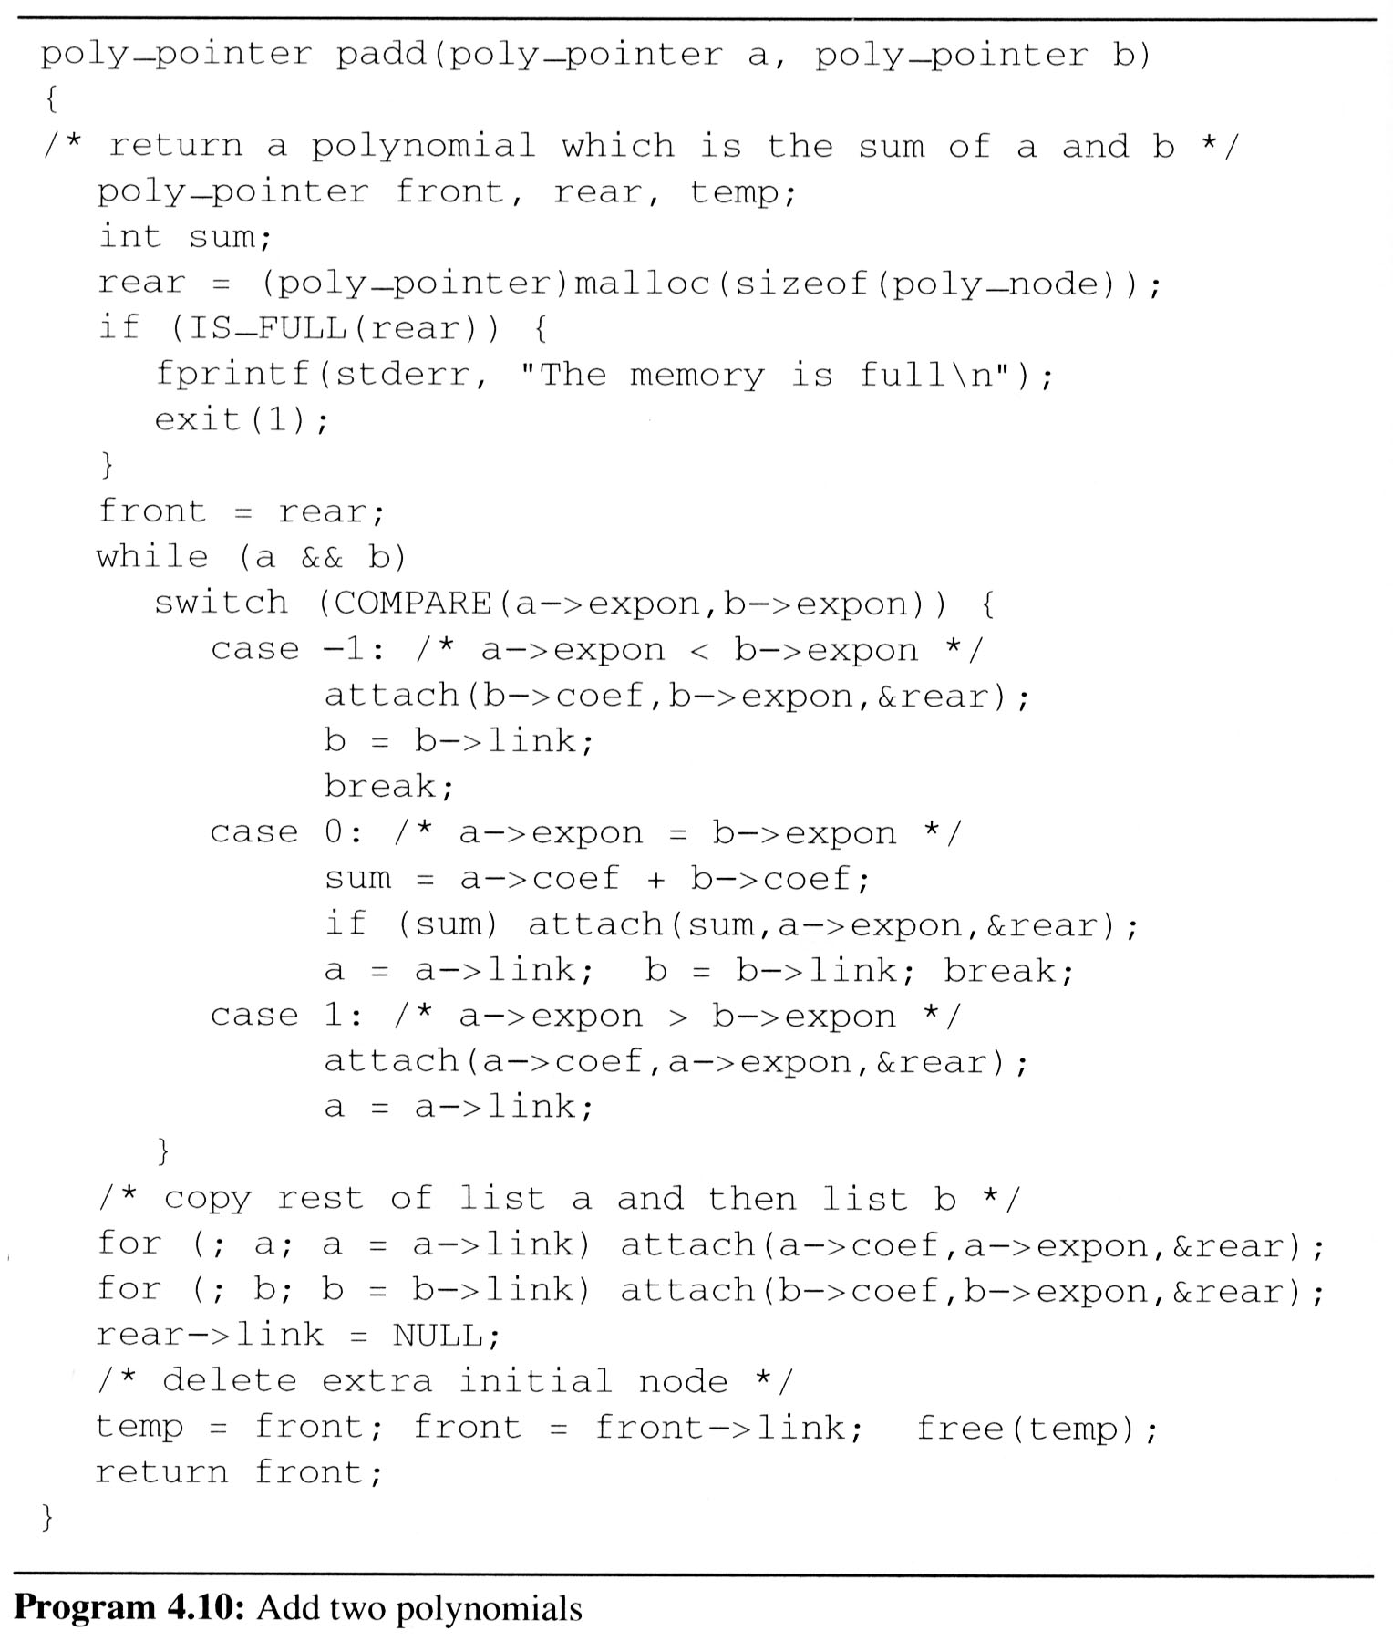
Polynomial Addition
Add two polynomials

Slide 51
Review Problems
Write a module to convert an unsorted linked list to a sorted linked list.
Use data structure conversion as opposed to a sort algorithm such as Bubble Sort or Merge Sort

Slide 52
Thank You

